Slide 1
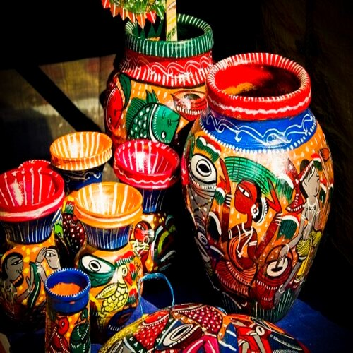
Business Plan
Handicrafts Item
Group 2

Slide 2

Business Idea
Set up a Handicrafts business
To give employment to rural craftsman and promote a
Self Reliant India.
Popularising and promoting the local culture and traditions.

Slide 3
Background
With the tremendous advancements in science and technology, the rural Indian markets are losing their identity and reach. Having been into the respective artform or skill in various crafts for generations, most of the craftsmen are not having much educational qualifications, thus more and more rural people are getting below the poverty line with every passing year.
This form of start-up is mostly to give employment to the rural people, making use of the talent and skills they already possess, along with bringing the beautiful, rustic items into the urban Indian households.

Slide 4
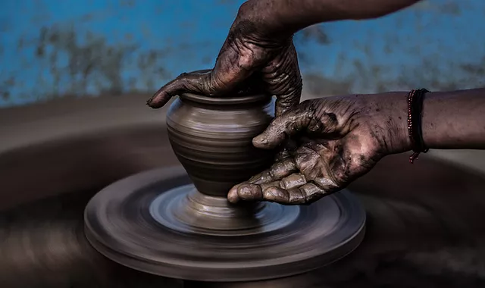
During the Covid-19 pandemic, things could not have gone worse for the artisan community. A falling economy, unemployment, reduced spending, the pandemic and subsequent lockdown have had a devastating impact on the handicrafts sector. Artisans and weavers are the third largest segment among the poor.
Thus, we aim to bridge the gap between the handicrafts production and the potential customers.

Slide 5
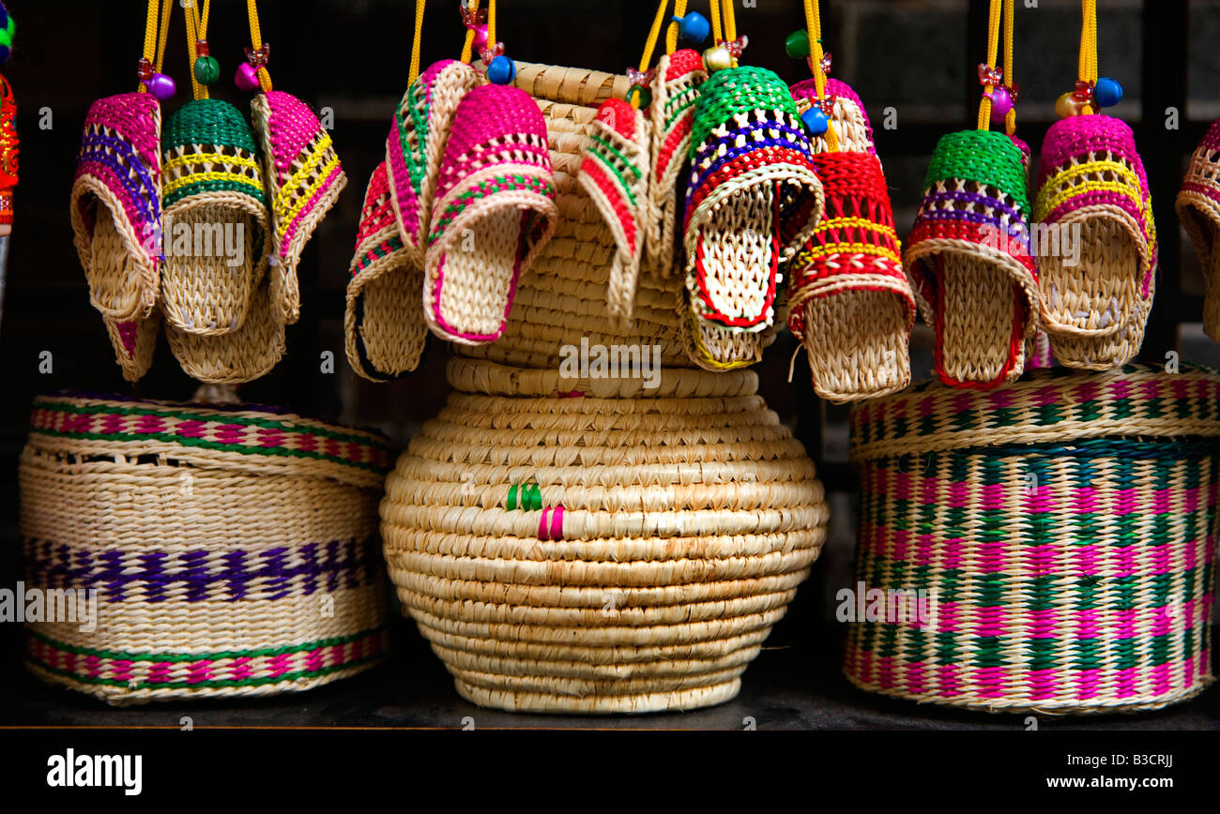
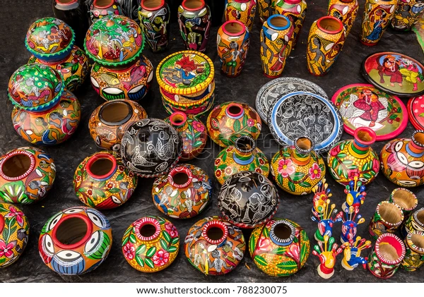
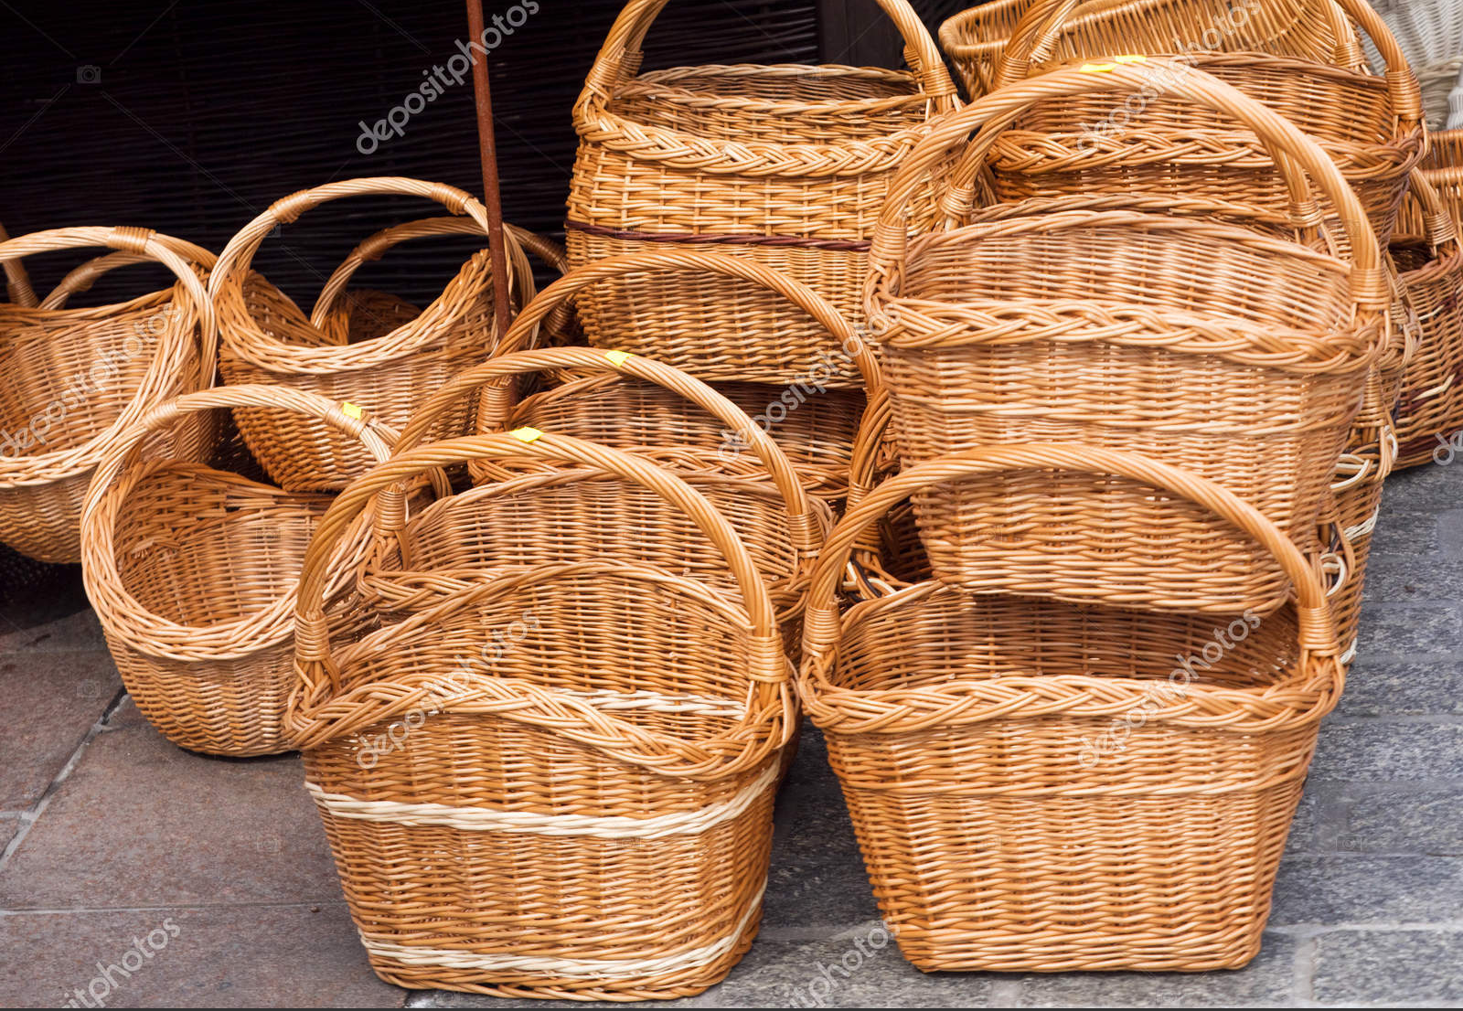
Products and services
Our products range from various items for example, wooden carvings, bamboo baskets, jewellery items, clay items, etc.
We will be available on both online and offline modes of set-ups, from where people can view our catalog of various items being offered. Thus, customers can choose and place orders on the online platform.
The delivery of the products to the homes of the customers will be taken care of by a Third-Party agency, whose online application we’ll be using.

Slide 6
Mission Vision
To be recognized as the leader in producing high quality products and services
To be known as market-driven company that strives for excellence, quality, performance and reliability.
To preserve and evolve indian craft and artisanal skills so they remain as integral part of our culture.
Develop, produce and market innovative handmade products.
To create enduring values for clients and customers in services through our innovative techniques.
To give employment to not only the rural craftsmen but also the urban people, as in, the sales team, web team.

Slide 7
Target Market
Before choosing a location for handicrafts business, we conducted our feasibility studies and market survey and we were able to identify the location that has the maximum untapped potential in terms of skilled craftsmen, considering the demand for our products and service offerings, we decided to settle for Andhra Pradesh.
For this we took into account several factors such as availability of raw materials, nearness to market, availability of infrastructure, economic policies, mindsets of people in a particular region etc.

Slide 8
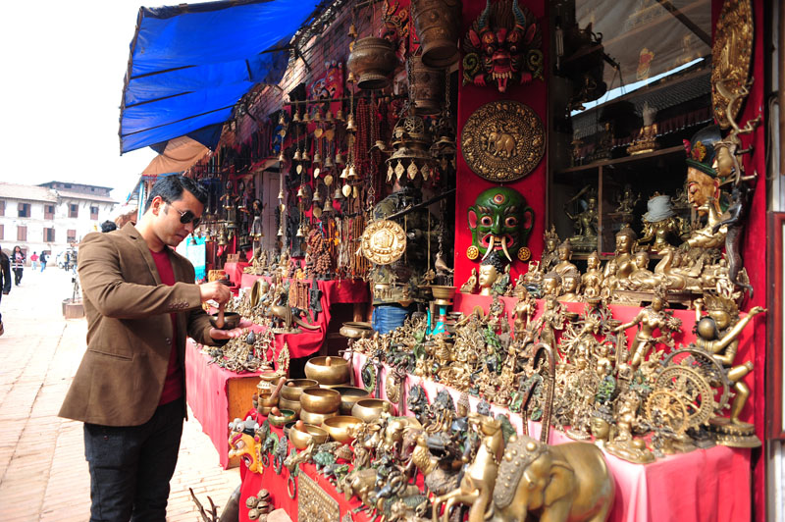
Potential Customers
The Middle and Upper class Indian households, who are willing to decorate their houses, at affordable prices.
Urban people mostly due to their rising earning and spending capability
Usually urban people have diverse lifestyles and they are known to be affluent and well-informed about the latest trends.

Slide 9
Market Analysis
As the Handicrafts sector has a great potential, in terms of employment, exports, etc., there are more and more start-ups coming up along with Government setups.
With the increase in demand and these products being the current day trend in markets, customers are in need of items which are not only attractive and aesthetic, but are also pocket-friendly.
So there is an increasing demand for affordable quality items in the urban areas, which is exactly where we want to come in handy and serve the purpose.

Slide 10
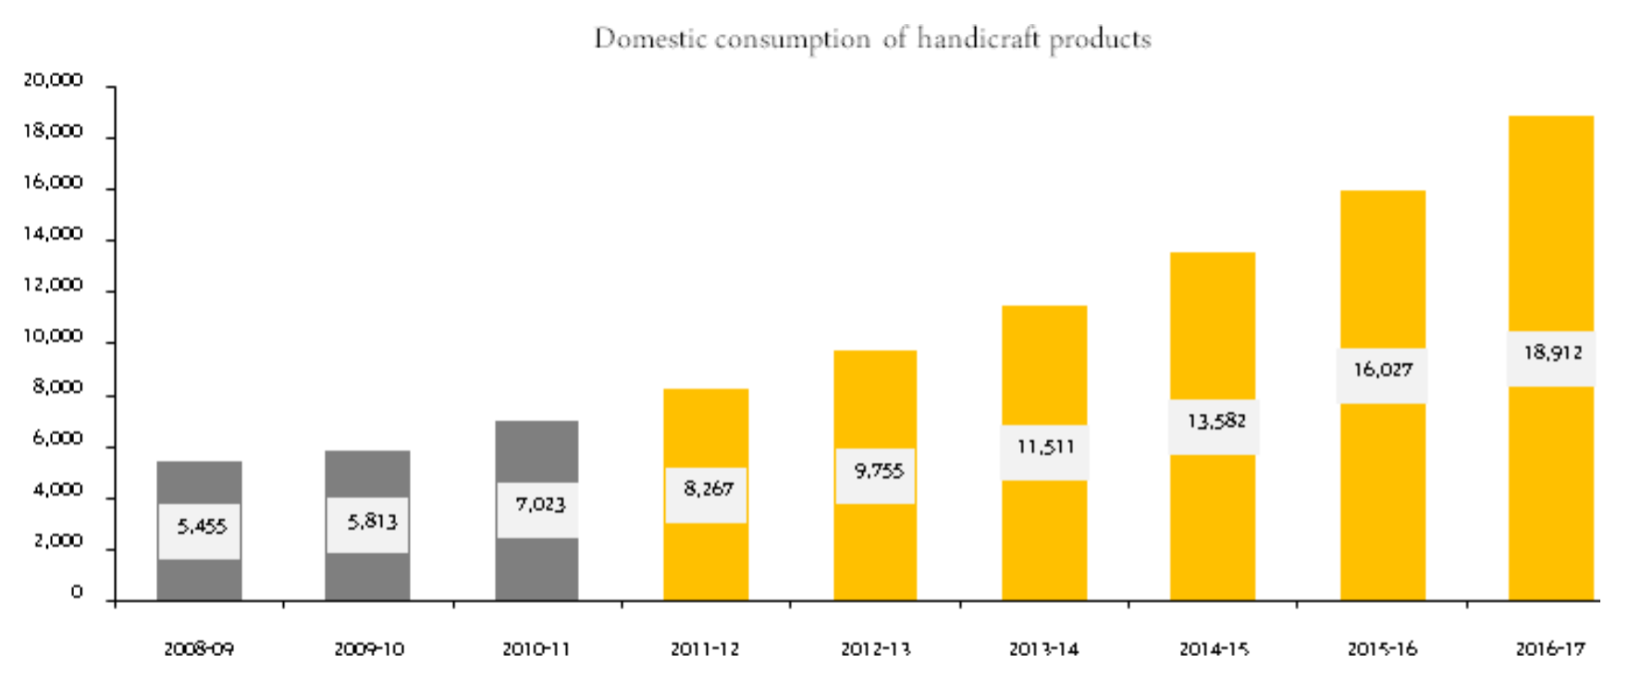
Domestic Consumption of Handicraft Products
INR,Crores
Financial Year

Slide 11
Competition | Advantage
Making our company products more attractive and creative so that we can attract more customers and get advantage over the other competing companies.
We also provide customized products for our customers.
All the local handicraft sellers.
Other sellers’ products available on online shopping websites such as Amazon, Flipkart.

Slide 12
Strategy
Sell at affordable prices.
Sell Non-toxic, Biodegradable, Attractive and Eco-friendly items.
Selling on a third party Marketplaces like flipkart, amazon, pinterest
We will work hard to procure a loyal customer base which further helps in word of mouth publicity.
Offering incentives to current customers if they refer a person who makes a purchase.
We also provide customized products to satisfy our customers.
We conduct timely surveys to know about customer satisfaction .
By following the above strategies we make sure that we satisfy our customers and earn their loyalty.

Slide 13
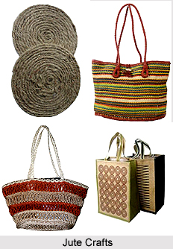
Marketing and sale strategies we will adopt are:
Promoting our brand on all social media platforms and popularising that our products are eco-friendly.
Maintaining a intimately unique website to attract customers and starting a blog.
Posting short documentary videos of our artisans and worker on our website blog.
Making paid promotions with social influencers.
Organising craft bazaars and participating in trade fests.

Slide 14
Business Model
Concept – We create and sell our own arts and craft products.
Production – Everything is done in house by our team.
Product Delivery Methods – Online website (Amazon, flipkart, etc.), or at our offline store.
Sales & Marketing – We are responsible for all levels of sales and marketing.
Location – Offline store in Tirupati, Andhra Pradesh.

Slide 15
Start-up Costs – Costs will be based on website services we require and specific production equipment and materials.
Strategic Goals :
Attain the production space, come in terms with the transportation services and the online sellers.
Hiring the teams: Artisan team, Web team, Sales team.
Start the offline store once we reach the sales income as twice of our initial investments and operational expenditure.
Give discounts to customers, so to speed up the income while having enough time to pay the loans timely.
Launch our own app, so we do not require to depend on the online partners

Slide 16
Management
Providing quality Customer services is our top priority.
We hire people who are passionate ,never willing to compromise on our company’s ethics and values and who are willing to help others in a team.
Chief executive officer
Finance manager
Human resource manager
Web Team
Artisan team
Offline shop manager
Sales staff

Slide 17
Revenue Model
Capital Expenditure | Expenditure(Rs.) Per Month
Raw materials | 1,00,000
Electricity | 10,000
Shop rent | 40,000
Online partners | 1,00,000(~15%)
Total | 1,60,000
Bank loans | 5,00,000

Slide 18
Initial Cost | Rupees
Exhibitions | 15,000
Skill development | 30,000
Tools and equipments | 20,000
Production house cum office | 10,00,000
Total | 10,65,000

Slide 19
Operational expenditure | Expenditure(Rs) Per Month
Artisan team | 2,00,000
Sales team | 28,000
Web team | 24,000
Advertisement | 5,000
Taxes | 50,000(~10%)
Transportation | 20,000
Total | 3,27,000

Slide 20
Sustainability And Expansion Strategy
We are aiming at having craftsmen skilled at more than one form of art or items. Everytime we make progress and create unique designs and patterns in one sector of art, the expansion process would be in two steps -
First, the aim would be to provide the items at wider range of locations
Second, to introduce a new form of art to the craftsmen as they reach to a certain level of affluence in the previous artform

Slide 21
Thank you !
Group 2
Members:
Udatha Anuradha - 19CH10062
Obilisetti Hanisha - 19EE10046
Matta Himabindu - 19EE10041
Tridipta Das - 19CH10061
Padmasree Neethipudi -19CH3PE01

